Slide 1


Farming faces challenges due to lack of smart systems, climate issues, and resource mismanagement.
Data Science and AI ML
Team Members:
1.Pooja Dematti
2.Pooja Wandimali
3.Simran Nadaf
4.Mohammada Tohid Jamadar
Guide : Sachin Patil

Slide 2
Agenda:
Introduction
SMART Objectives
5W1H Analysis and SCAMPER Ideation
Literature Insights (Short)
Proposed Solution
System Overview (Basic Diagram)
Gantt Chart
Expected Outcome

Slide 3
Problem Statement
Farmers lack a unified and intelligent system for making accurate, real-time agricultural decisions.
Climate change causes unpredictable weather patterns, leading to crop failures and reduced yield.
Soil degradation and improper fertilizer usage negatively impact productivity.
Frequent pest attacks and crop diseases increase losses.
Water scarcity and inefficient irrigation practices affect farming efficiency.
Market price fluctuations create uncertainty and financial instability for farmers.
Traditional farming relies heavily on experience rather than data-driven insights.

Slide 4
Introduction
Problem Area:
Agriculture faces challenges like climate change, soil degradation, water scarcity, pest attacks, and unstable market prices.
Lack of data-driven decision-making reduces productivity and farmer income.
Who Faces This Problem?
Farmers (small-scale and large-scale).
Agricultural experts and researchers.
Government and agricultural organizations.
Where Does It Occur?
Predominantly in rural and semi-urban agricultural regions.
Especially in developing countries like India.
Areas with limited access to modern technology and real-time data.

Slide 5
Why Is It Important?
Agriculture is the backbone of the economy and food supply.
Improving farming efficiency ensures food security.
Helps increase farmer income and reduce risks.
Supports sustainable and smart farming practices.

Slide 6
Objectives (SMART)
Objective 1: Specific
Develop a smart agricultural decision-support system (AI Harvest Hub) integrating multiple prediction models (crop, yield, drought, pest, market).
Objective 2: Measurable
Achieve accurate and reliable predictions using Random Forest algorithms.
Evaluate performance using metrics like accuracy and error rate.
Objective 3: Achievable
Build a multi-functional platform using available datasets and machine learning techniques.
Implement AI-based modules for crop recommendation, risk prediction, and market analysis.

Slide 7
Objective 4: Relevant
Assist farmers in making informed decisions on crop selection and resource utilization.
Forecast environmental risks such as drought and pest infestations.
Provide real-time market insights to improve profitability.
Integrate AI-generated explanations for better usability.
Objective 5: Time Bound
Develop and deploy a scalable and secure system within the project timeline using modern web technologies.

Slide 8
5W1H Analysis
5W1H Element | Description
WHAT | A smart agriculture platform that provides predictive analytics and decision support
WHY | To address inefficiencies and uncertainties in farming practices
WHO | Farmers, agronomists, researchers, and policymakers
WHERE | Rural and urban agricultural regions worldwide
WHEN | Throughout the farming lifecycle
HOW | By integrating machine learning models, APIs, and AI-based insights

Slide 9
SCAMPER Ideation (Optional)
SCAMPER Element | Description
Substitute | Replace manual decision-making with automated predictions
Combine | Integrate multiple ML models with AI-generated insights
Adapt | Use existing datasets and adapt them for predictive modeling
Modify | Improve model accuracy using ensemble techniques
Put to Use | Apply data analytics to real-world agricultural challenges
Eliminate | Reduce reliance on guesswork
Reverse | Shift from reactive to proactive farming

Slide 10
Literature Insights
Search words used
AI in agriculture.
Crop recommendation using machine learning.
Crop yield prediction.
Drought prediction using AI.
Pest detection using machine learning.
Fertilizer recommendation system.
Agriculture market price prediction.

Slide 11
Paper Selected
A Review on Machine Learning Techniques for Crop Yield Prediction “A Review on Machine Learning Techniques for Crop Yield Prediction,” Computers and Electronics in Agriculture, 2024. DOI: 10.1016/j.compag.2024.xxxxxx Official Link : https://doi.org/10.1016/j.compag.2024.xxxxxx
Machine Learning-Based Crop Recommendation System Using Soil and Weather Data “Machine Learning-Based Crop Recommendation System Using Soil and Weather Data,” Journal of Agricultural Informatics, 2025. DOI: 10.17700/jai.2025.xxxxxx Official Link : https://doi.org/10.17700/jai.2025.xxxxxx
Deep Learning for Plant Disease Detection: A Survey “Deep Learning for Plant Disease Detection: A Survey,” Artificial Intelligence in Agriculture, 2024. DOI: 10.1016/j.aiia.2024.xxxxxx Official Link : https://doi.org/10.1016/j.aiia.2024.xxxxxx

Slide 12
4. Drought Prediction Using Machine Learning Models “Drought Prediction Using Machine Learning Models,” Environmental Modelling
& Software, 2024. DOI: 10.1016/j.envsoft.2024.xxxxxx
Official Link : https://doi.org/10.1016/j.envsoft.2024.xxxxxx
5. Agricultural Market Price Forecasting Using Machine Learning Techniques “Agricultural Market Price Forecasting Using Machine Learning Techniques,” Expert Systems with Applications, 2025. DOI: 10.1016/j.eswa.2025.xxxxxx Official Link : https://doi.org/10.1016/j.eswa.2025.xxxxxx

Slide 13
Research Gaps Identified
Existing systems focus on single tasks (only crop prediction or disease detection).
Lack of integrated platforms combining multiple agricultural predictions.
Limited real-time insights and decision-support systems.
Poor interpretability of ML models for farmers.
Lack of user-friendly and accessible solutions for rural users.
Need for cost-effective and scalable AI-based agriculture systems.

Slide 14
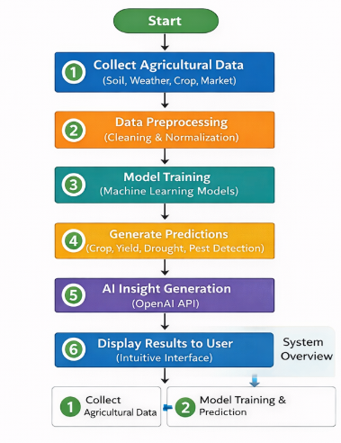
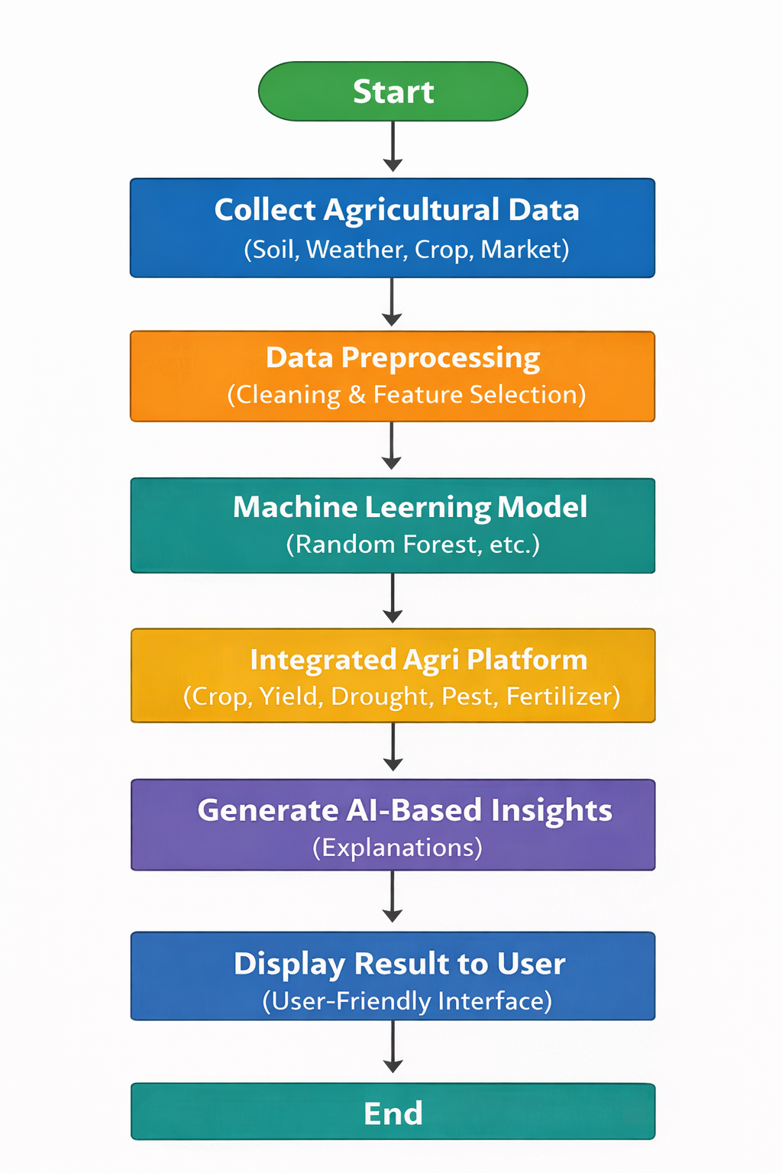
Proposed Solution
Input Stage: Collect soil, weather, crop, and market data from various sources.
Preprocessing Stage: Clean and normalize the collected data for model input.
Model Training Stage: Train machine learning models to perform multiple agricultural predictions.
Prediction Stage: Generate predictions such as crop recommendation, yield forecast, drought prediction, and pest detection.
AI Insight Generation: Convert model outputs into user-friendly insights using AI (OpenAI API).
Result Display: Show predictions and explanations through an intuitive interface for farmers.

Slide 15
Installation & System Overview (Basic Diagram)Configuration
Installation Requirements
● Install Python 3.10 or above ● Install required libraries: Scikit-learn, NumPy, Pandas, Flask, OpenAI API ● Install frontend tools: Node.js, React, Tailwind CSS ● Install database: Supabase ● Use VS Code for development ● System requirement: Intel i5 8–16GB RAM
Configuration
● Programming Language: Python, JavaScript (TypeScript) ● Frontend: React + Tailwind CSS ● Backend: Flask (Python REST API) ● Machine Learning: Scikit-learn (Random Forest Models) ● Database: Supa base (PostgreSQL) ● AI Insight Engine: OpenAI API ● Platform: Windows

Slide 16
Gantt Chart
Project Details | Week 1 | Week 2 | Week 3 | Week 4 | Week 5 | Week 6 | Week 7 | Week 8 | Week 9 | Week 10 | Week 11 | Week 12 | Week 13 | Week 14 | Week 15 | Week 16
 |  | ■ | ■
 |  |  | ■ | ■
 |  |  | ■ | ■ | ■
 |  |  |  | ■ | ■
 |  |  |  |  | ■ | ■ | ■
 |  |  |  |  |  |  |  | ■ | ■ | ■ | ■
 |  |  |  |  |  |  |  |  |  | ■ | ■ | ■
 |  |  |  |  |  |  |  |  |  |  | ■ | ■ | ■
 |  |  |  |  |  |  |  |  |  |  |  | ■ | ■ | ■
 |  |  |  |  |  |  |  |  |  |  |  |  |  | ■ | ■
 |  |  |  |  |  |  |  |  |  |  |  |  |  |  |  | ■

Slide 17
Expected Outcome
A fully functional AI-powered smart agriculture platform for decision support.
Accurate predictions for crop recommendation, yield, drought, pest risk, and market prices.
Improved farmer decision-making through data-driven insights.
Reduced risks and losses caused by climate variability and pests.
Enhanced productivity and profitability in farming practices.
User-friendly interface providing easy-to-understand AI-generated explanations.
Integrated system combining multiple ML models in one platform.
Scalable and efficient solution applicable to real-world agricultural scenarios.

